Slide 1
The Black-Scholes Equation in Finance
Nathan Fiedler Joel Kulenkamp
Steven Koch Ryan Watkins
Brian Sikora

Slide 2
Objective
Our main objective is to find the current price of a derivative.
Derivatives are securities that do not convey ownership, but rather a promise to convey ownership.

Slide 3
Didn’t we do this already?
What we did:
Proved the non-existence of Arbitrage
Using this fact we derived the Risk Neutral Pricing Formula
Calculated the current price that should be paid for the derivative using the pricing formula

Slide 4
What’s next then?
Review of the Single-Period Model
Expand this concept into the
Multi-Period Model
Derive the Black-Scholes Equation
Solution to Black-Scholes

Slide 5
Review of the One–Period Mathematical Model

Slide 6
One–Period
Mathematical Model
The one-period mathematical model has two times to be concerned with.
There is t = 0 (the present) and t = T (some future time) in which we don’t know what will occur.
This mathematical theory relies heavily on the concept that there is a finite number of possible future states of the world.

Slide 7
One–Period Mathematical Model (cont.)
Some examples of possible future states of the world are the occurrence of a flood, or the election of a new president, both of which could have some positive or negative impact on the financial market of the world.
The important idea here is that we make investment decisions now (at t = 0), which will, in general, lead to uncertain outcomes in the future (at t = T), depending on which future states of the world actually do occur.

Slide 8
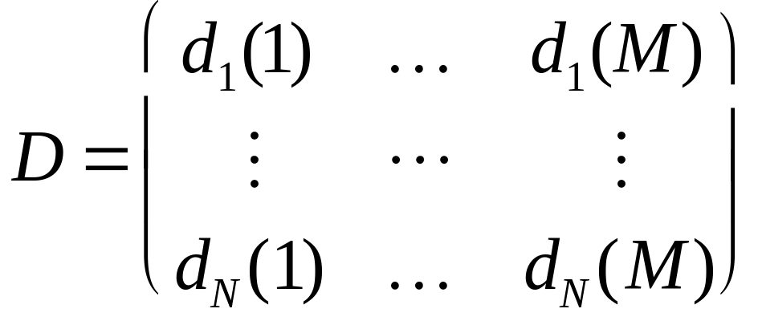
One–Period Mathematical Model (cont.)
In a one-period model, a market is a list of security d_{1, ….,} d_{N} and can be represented by it’s N x M pay-out matrix D which has N securities and M future possible states of the world.

Slide 9
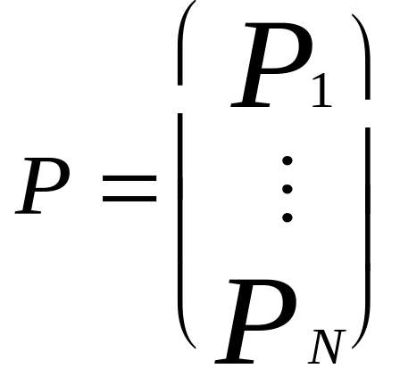
One–Period Mathematical Model (cont.)
This pay-out matrix gives the amount each security pays in each state of the world.
The prices of the securities are given by the N-vector, where P_{j} is the money you have to invest to acquire one unit of security j.

Slide 10

Arbitrage
The concept of arbitrage means an investor can invest in a security at no risk and they are guaranteed a positive profit in all future states of the world.
However, arbitrage does not exist in real-life financial situations so the Arbitrage Theorem states that a state-price vector the cost to initiate a security is equivalent to the pay-out matrix multiplied by the state-price vector

Slide 11
Arbitrage (cont.)
In a one-period model, you can calculate the current price of a derivative by using the Risk Neutral pricing Formula if you assume a few things. The following should be true:
    there are only two possible future states of the world
    you have a three-asset market consisting of a stock, a bond, and a derivative which has just been introduced into the market.

Slide 12
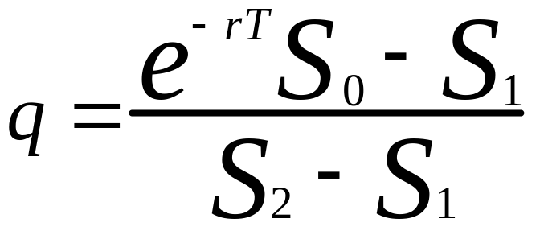
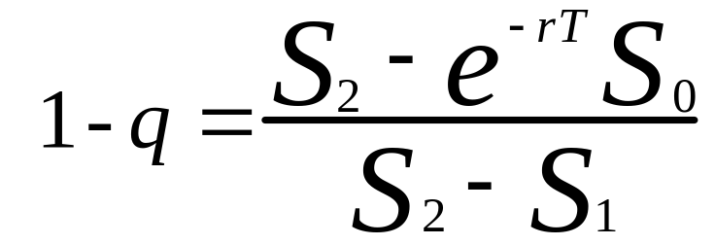
Arbitrage (cont.)
The Risk Neutral Pricing Formula is: V₀ = e^{-rT}(qV₂+(1-q)V₁) where
and

Slide 13
Risk Neutral Pricing Formula Variables
Note the following information in regard to the previous equations:
S₀ = the current price of the stock
V₀ = the current price of the derivative
e^{-rT} = the discount factor of the bond with a fixed interest rate and time
S₁ and S₂ = the two projected future prices of the stock
V₁ and V₂ = the two projected future prices of the derivative

Slide 14
Multi-Period Model and Binomial Trees

Slide 15
Multi-Period Model
The one-period model easily extends to a multi-period model.
Assumptions for simplicity:
- The interval from t = 0 to t = T is
divided into N sub-intervals
- Our market only consists of a
single stock and a bond

Slide 16
Binomial Tree with
N = 3 Time-Levels
S₂₃ S₃₄
S₁₂
S₂₂ S₃₃
S S₀₀ S₃₂
S₁₁
S₂₁ S₃₁
(t) t₀ t₁ t₂ t₃

Slide 17
Multi-Period Model and Binomial Tree
If a derivative security enters our market and we know all it’s values at time t_{N}, you can use the Risk Neutral Pricing Formula:
V₀ = e^{-rT}(qV₂ + (1-q)V₁)
to determine the price of the derivative at each node.

Slide 18

Multi-Period Model and Binomial Tree
We are going to be taking
But we first need to define a structure for our tree. We need to define the following constants:
u, d, s, h, k

Slide 19
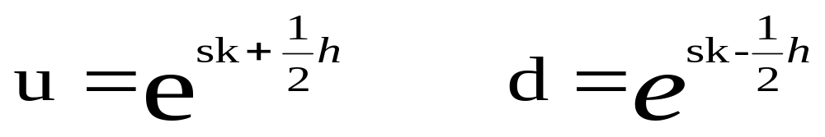
Multi-Period Model and Binomial Tree
Let’s define the up (u) and down (d) ratios as follows:
Note:
u and d will be constant on the entire tree
For each time step, a stock price can either gain a fixed percentage (u) or lose a fixed percentage (d)

Slide 20
Multi-Period Model and Binomial Tree
In our u and d equations,
k = T/N (representing the final time divided by the number of sub-intervals)
h = some measure of spread between u and d ratios
s = centering term of our binomial tree

Slide 21
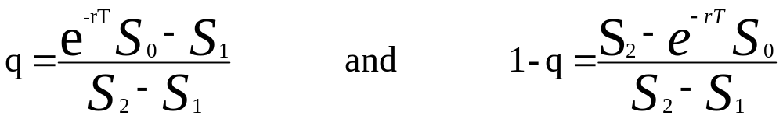
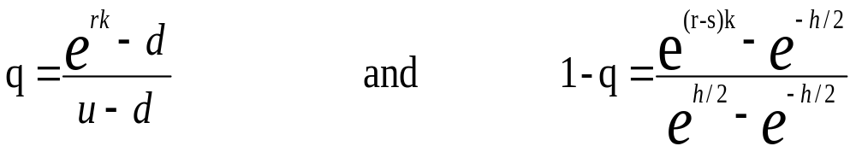
Multi-Period Model and Binomial Tree
Recall that in the one-period model:
Now if we apply u, d, s, h, and k to these equations for q and 1-q, we get:

Slide 22
Multi-Period Model and Binomial Tree
We can again rewrite the Risk Neutral Pricing Formula as follows:
V_{i,j} = e^{-rk}(qV_{i+1,j+1} + (1-q)V_{i+1,j})
This equation allows us to compute the price of the derivative at each node in the binomial tree working our way from t_{N} backwards to t₀.

Slide 23
The Continuum Limit

Slide 24
The Continuum Limit
We have just derived the formula to compute V_{i,j} one level at a time
This idea will now be expanded by allowing the time intervals on the recombinant tree to shrink even more.
V_{i,j} = e^{-rk} (q V_{i+1,j+1} + (1-q)V_{i+1,j} )

Slide 25
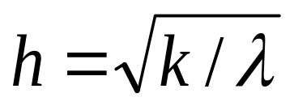
The Continuum Limit (cont.)
To allow these intervals to shrink, we let N approach ∞
This also means letting k, the distance between two subsequent times, approach 0
Before we can take the limit of k, we must set s to be a constant and h as

Slide 26
The Continuum Limit (cont.)
The limit k→0 can be found using the process of finite-difference analysis
Using this gives us a partial differential equation that can be later transformed into the Black-Scholes equation
First, let’s look at one particular time interval of the recombinant tree.

Slide 27
The Continuum Limit (cont.)
V_{i+1,j+1}
h₊
V_{i,j} k O
h₋
V_{i+1,j}
In this part of the tree, the lengths h₊ and h₋ are
h₊ = (u - 1)S_{i,j}
h₋ = (1 - d)S_{i,j}

Slide 28
The Continuum Limit (cont.)
In this tree, S_{i,j} is the vertical coordinate of the center point O
Also, S_{i,j} can be considered another representation of the point V_{i,j}
We are now ready for using finite-difference analysis to find the limit k→0

Slide 29
The Continuum Limit (cont.)
Finite-difference analysis says that the derivative values V_{i,j} approach a smooth function of two variables, V(S,t), that can be used to solve a future partial differential equation
By using Taylor expansion, we get the following equations for the points V_{i,j}

Slide 30
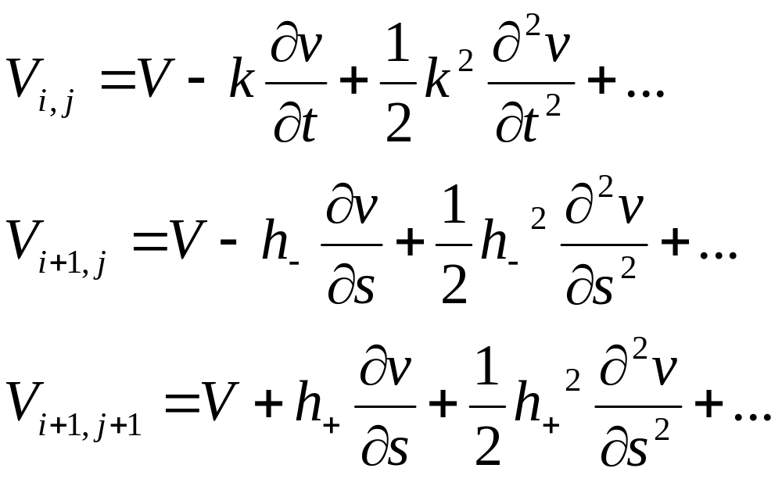
The Continuum Limit (cont.)
With the expanded representations, we can substitute these values into our formula for computing any V_{i,j} in the tree.

Slide 31
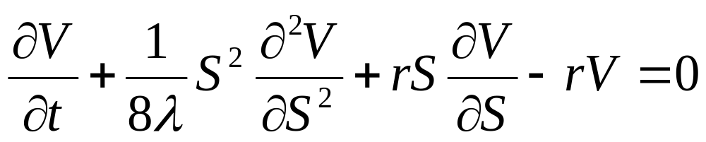
The Continuum Limit (cont.)
By expanding everything in powers of h and checking the leading term in the error, we arrive at the following equation

Slide 32
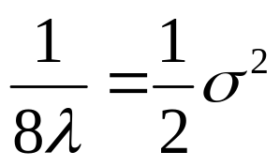
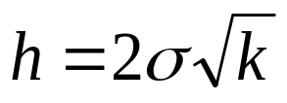
The Continuum Limit (cont.)
We will now introduce a new parameter called the volatility, denoted by σ.
The volatility σ will replace a term in the previous equation, namely
We can now define h in a new way using σ

Slide 33
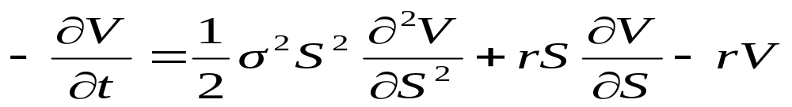
The Continuum Limit (cont.)
By substituting the volatility parameter σ in our derived equation, we get the standard Black-Scholes equation.
Side condition: V(S,T) = (S), where  is the derivative contract

Slide 34
Solving the Black-Scholes Equation

Slide 35
Black-Scholes equation
  Partial differential equation
  Backwards parabolic
  Linear
  Variable coefficients
    Depend on the variable S

Slide 36
Solving PDEs
Partial differential equations
  Generally difficult to solve
  Easiest PDEs to solve
    Linear
    Constant coefficients
Black-Scholes equation
  Linear
  Variable coefficients

Slide 37
Obtaining Constant Coefficients
Perform a change of variables
  Done similar to the previous group
  Changing the variable S
    S only appears in pair with DV/DS
    Use logarithmic function for the change
  Changing the variable t
    Only done to simplify the form

Slide 38
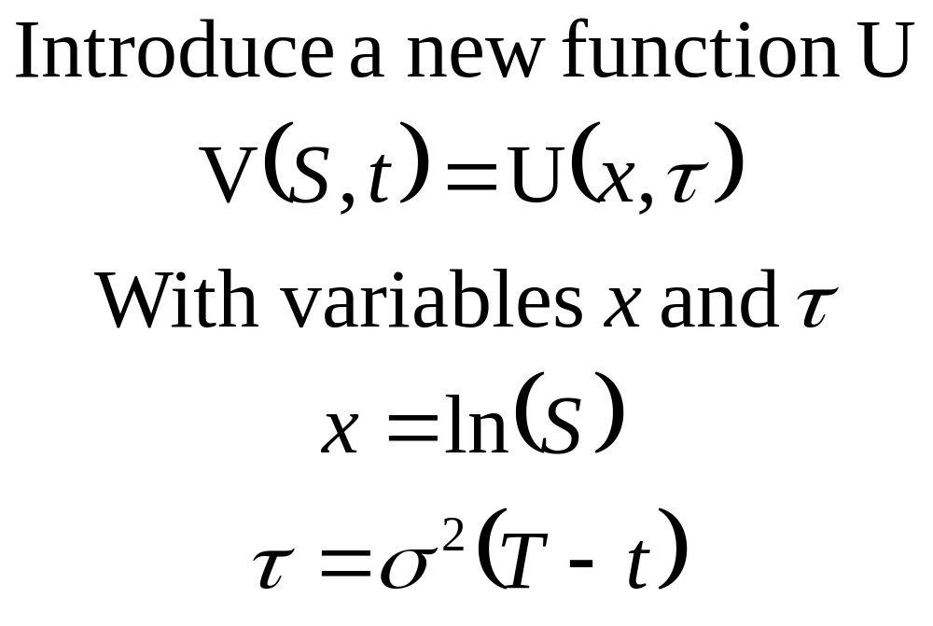

Slide 39
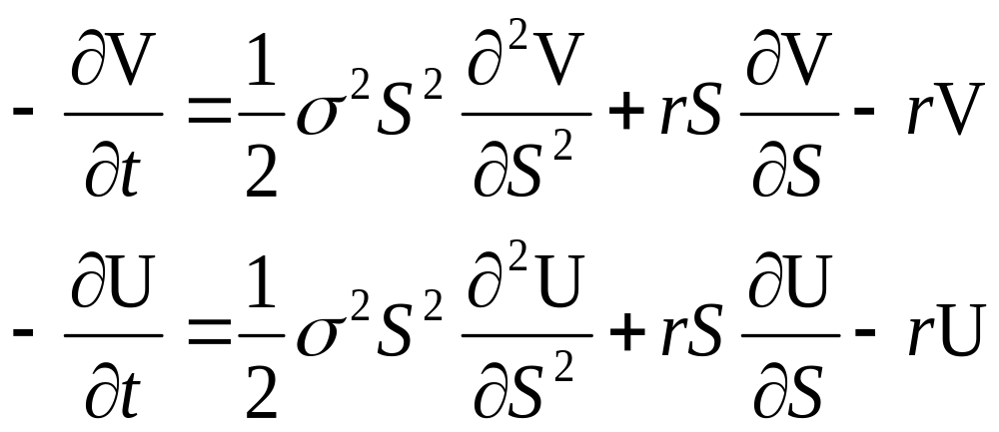
Change in function notation
By the chain rule...

Slide 40
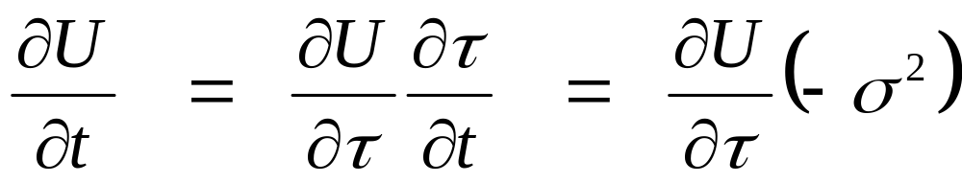
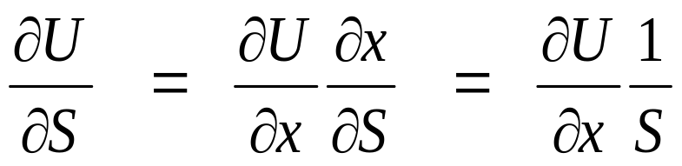
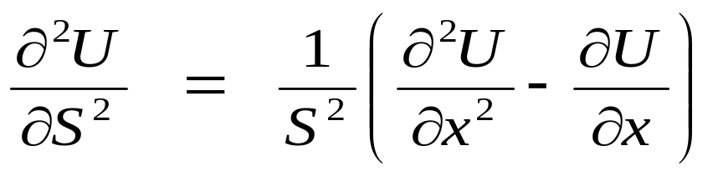
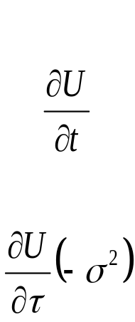
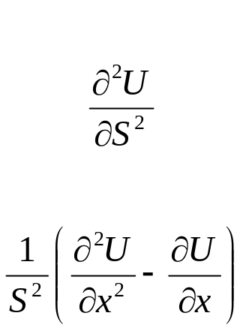
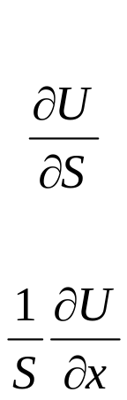
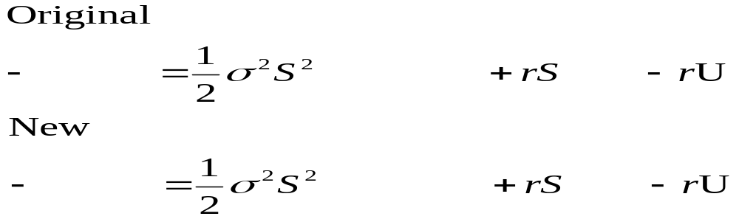
Calculate the partials

Slide 41
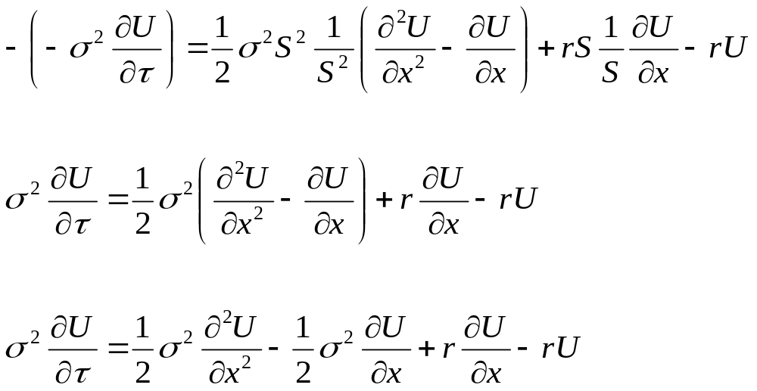
Simplification

Slide 42
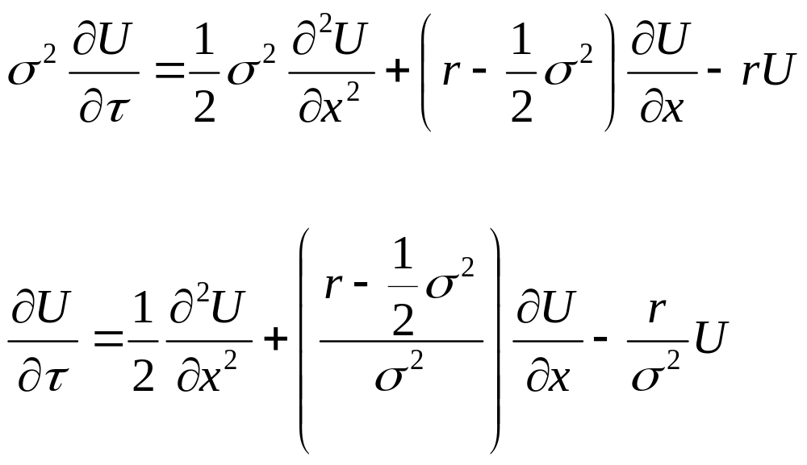
Simplification

Slide 43
Equation Properties
New PDE properties
  linear
  constant coefficients
    depend on the constants r and tau
  solvable with Green’s functions

Slide 44
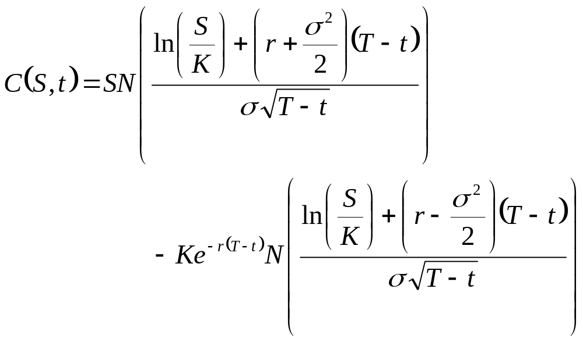
Solution Using Green’s functions

Slide 45
Summary

Slide 46
Summary
Expansion of the Single-Period Model into the Multi-Period Model
Using the Continuum Limit we derived the Black-Scholes Equation
Found an abstract solution to the Black-Scholes Equation

Slide 47
References
Dr. Steve Deckelman
“Finance in Tulips”
    Math Models I presentation
“Mathematics in Finance”
    by Robert Almgren
Advanced Calculus
    by Fitzgerald
Introduction to Linear Algebra(4th ed.)
    by Johnson, Reiss, Arnold

